Slide 1
Lesson objective
Title: Introducing negative numbers
Aim:
Compare and order integers using a number line
Plan:
Daily review
Walking the (number) line
Comparing integers

Slide 2

Daily review
The opposite of a number is going to be the opposite ____ of that ______.
What is the opposite of:
3
-5
43
What numbers are missing from these number lines?

Slide 3
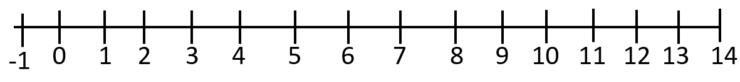
The difference between integers
The difference between integers is the value that “connects” the numbers on the number line. E.g.
The difference between 9 and 4 is 5
The difference between -1 and 6 is 7
Notes:
What would be the difference between -4 and -10?

Slide 4

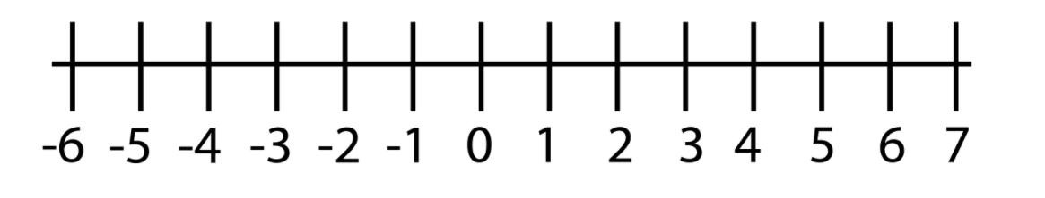
Number line and opposite numbers
NUMBERS GET BIGGER
NUMBERS GET SMALLER
So -6 is smaller than 0
Number lines do not always go up by 1***

Slide 5
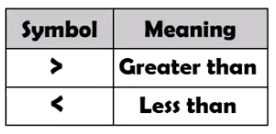
Inequalities
Inequality: a mathematical sentence that compares two numbers.
-3 ? 0
-3 < 0

Slide 6
Inequalities
Inequality: a mathematical sentence that compares two numbers.
-6 ? 2
-6 < 2

Slide 7
Whiteboards
Using the > or < symbols, compare the following numbers.
(remember the “crocodile” eats the larger number)
4 ? 10
0 ? -1
-12 ? 11
-1 ? -4

Slide 8
Ordering integers
Ascending – means going from small to large.
Descending – means going from large to small.
Put the numbers -1, 5, -4 and 2 in ascending order
The smallest number is the number further to the left.
NUMBERS GET BIGGER
NUMBERS GET SMALLER

Slide 9
Ordering integers: ascending
I do
We do
7, -2, 6, 0, -5, -7
3, 0, -1, - 4, 8, -5
1, 0, -2, 5, 3, -7
8, 0, -4, 11, -2, 9, 1, -8

Slide 10
In your exercise book, evaluate the following:
Draw > or < to indicate the larger number
12 15
18 3
-4 0
-12 -8
0 -4
Order these sets of numbers in ascending order
(you can draw a number line on your whiteboard)
8, 2, 4, 12, -2, 0
14, -5, 12, 0, -2, -1
-1, -4, 0, -9, -7, -10
3, -1, 0, 4, 8, -5, -9
Complete these simple patterns
8, 9, 10, ___, ___, ___
2, 4, 6, 8, ___, ___, ___
-3, -2, ___, 0, ___, 2, 3
-10, -5, ___, ___, 10

Slide 11
Puzzle practice
Start on “MR and MRS Larger had a baby. Who was the Largest?”

Slide 12
True or false?
5 > 4
17 > 24
-1 > 0
-15 < -5
-120 > 100
- 3 > -4

Slide 13

Reflection
How did we do?
Aim:
Compare and order integers using a number line
Example, can you put these in ascending order?
10, -5, 0, 11, 4, - 2

